Slide 1
Magnetic Gear
10
Ondřej Sedláček
FOR TEAM GCHD

Slide 2
Table of contents
Introduction
Task definition
Relevant parameters and phenomena
Magnetic coupling
Simulation and testing
Torque transfer
Determining drag
(Measuring spinner parameters)
Summary

Slide 3
Task definition
Introduction
Take several identical fidget spinners and attach neodymium magnets to their ends. If you place them side by side on a plane and rotate one of them, the remaining ones start to rotate only due to the magnetic field. Investigate and explain the phenomenon.
We focused on the transfer of torque and angular velocity for 2 spinners, since anything above that starts behaving chaotically and is hard to quantitatively measure.
We always kept all the spinners in one plane and firmly put in place, so that they wouldn’t move around.
We used identical spinners with identical magnets and magnet counts.
Notes:
Focused on torque and angular velocity
We analytically described drag

Slide 4
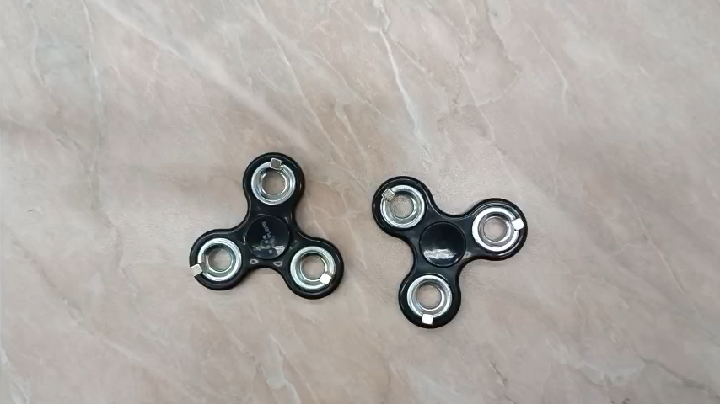
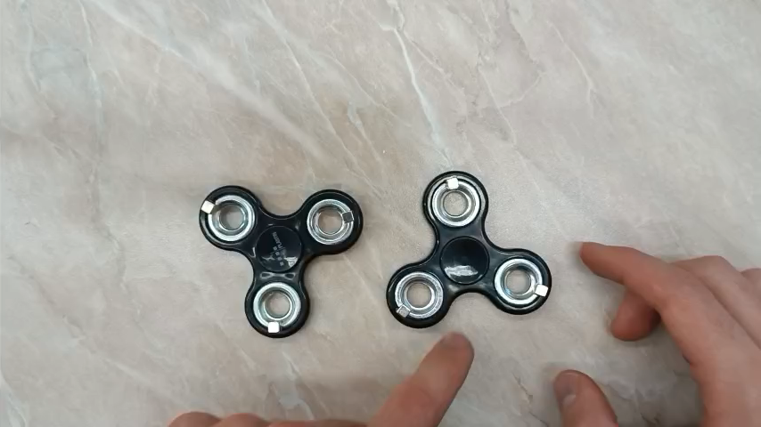
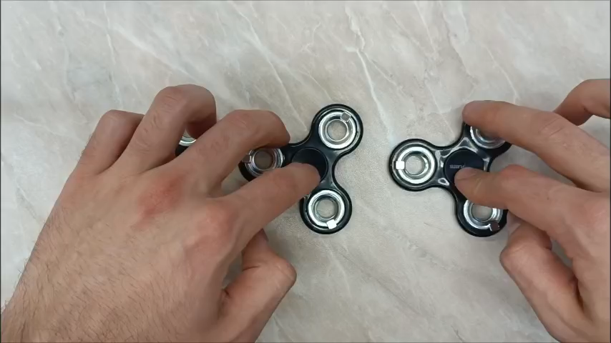
Observed behaviour
Introduction
A quickly rotating spinner acts similarly to a permanent magnet
Two spinners start behaving chaotically at low RPM
We also experimented with multiple spinners, but we were unable to come to any conclusions
Notes:
We should add some simple examples/videos, so that everyone catches on
Take the spinners with magnets and the spinner with the metal plate with me! Take the magnetic transmission as well!

Slide 5
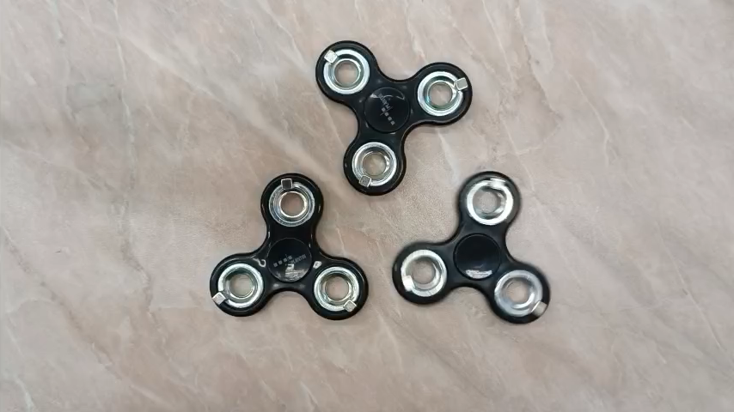
More examples
Additional information
We also experimented with spinners, that were not inline => even more chaotic

Slide 6
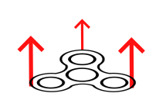
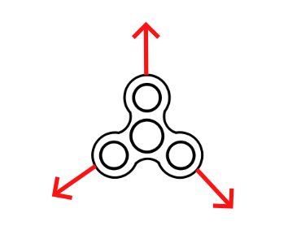
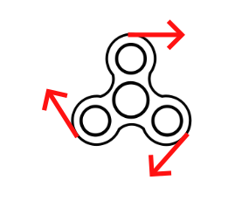
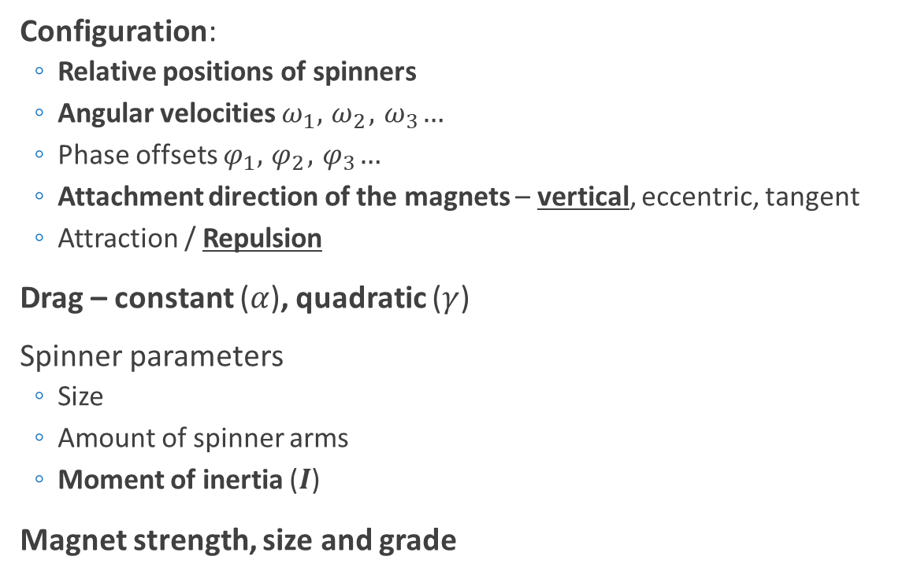
Relevant parameters
Introduction
Configuration:
Relative positions of spinners
Angular velocities $ω_{1},{ ω}_{2}, { ω}_{3}…$
Phase offsets $φ_{1},{ φ}_{2}, { φ}_{3}…$
Attachment direction of the magnets – vertical, eccentric, tangent
Attraction / Repulsion
Drag – constant ($α$), quadratic ($γ$)
Spinner parameters
Size
Amount of spinner arms
Moment of inertia ($I$)
Magnet strength, size and grade
Vertical
Eccentric
Tangent
Notes:
We chose the vertical orientation, since it held on the easiest.
Other configuration might‘ve improved the torque tranfer, since B interactions are non-zero.

Slide 7
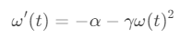
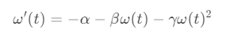
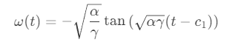
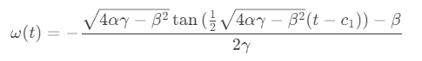
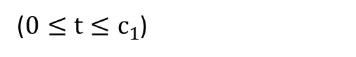
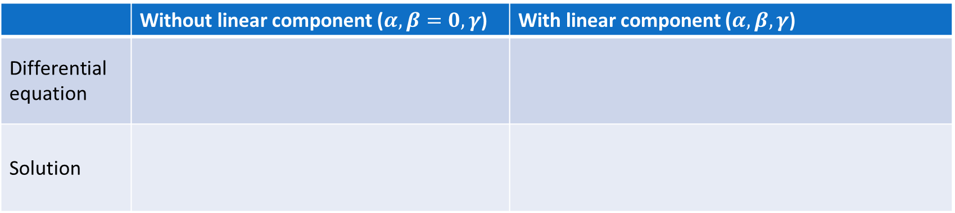
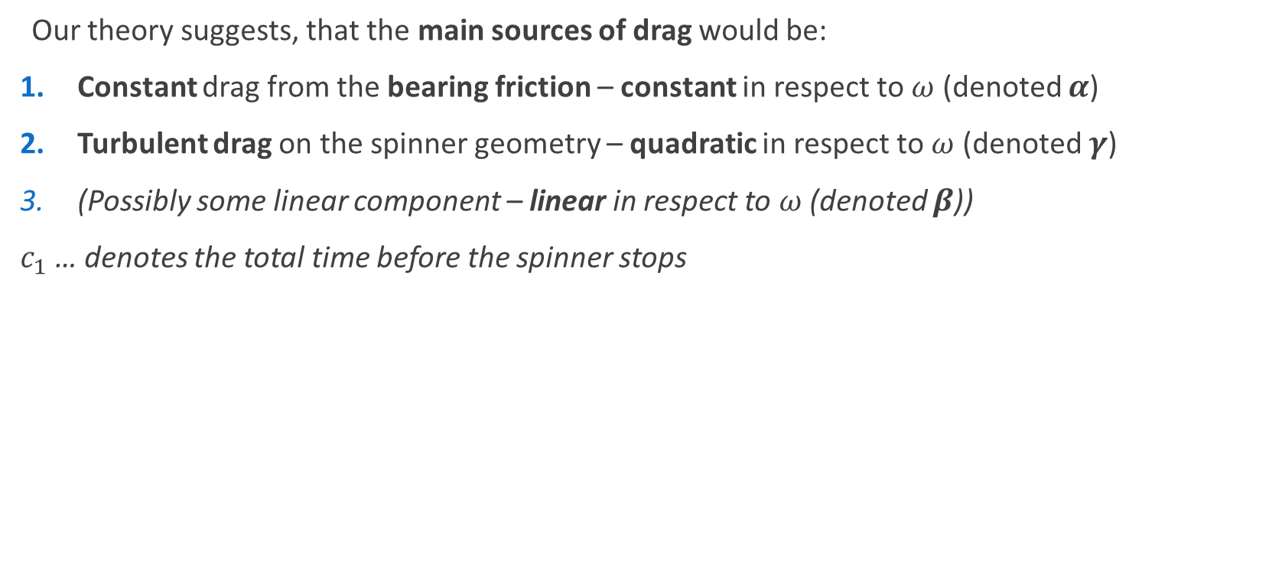
Drag – Analytical solution
Measurements
Our theory suggests, that the main sources of drag would be:
Constant drag from the bearing friction – constant in respect to $ω$ (denoted $α$)
Turbulent drag on the spinner geometry – quadratic in respect to $ω$ (denoted $γ$)
(Possibly some linear component – linear in respect to $ω$ (denoted $β$))
$c_{1}$ … denotes the total time before the spinner stops
 | Without linear component ($α,β=0, γ$) | With linear component ($α,β,γ$)
Differential equation
Solution
($0≤t≤c_{1}$)

Slide 8
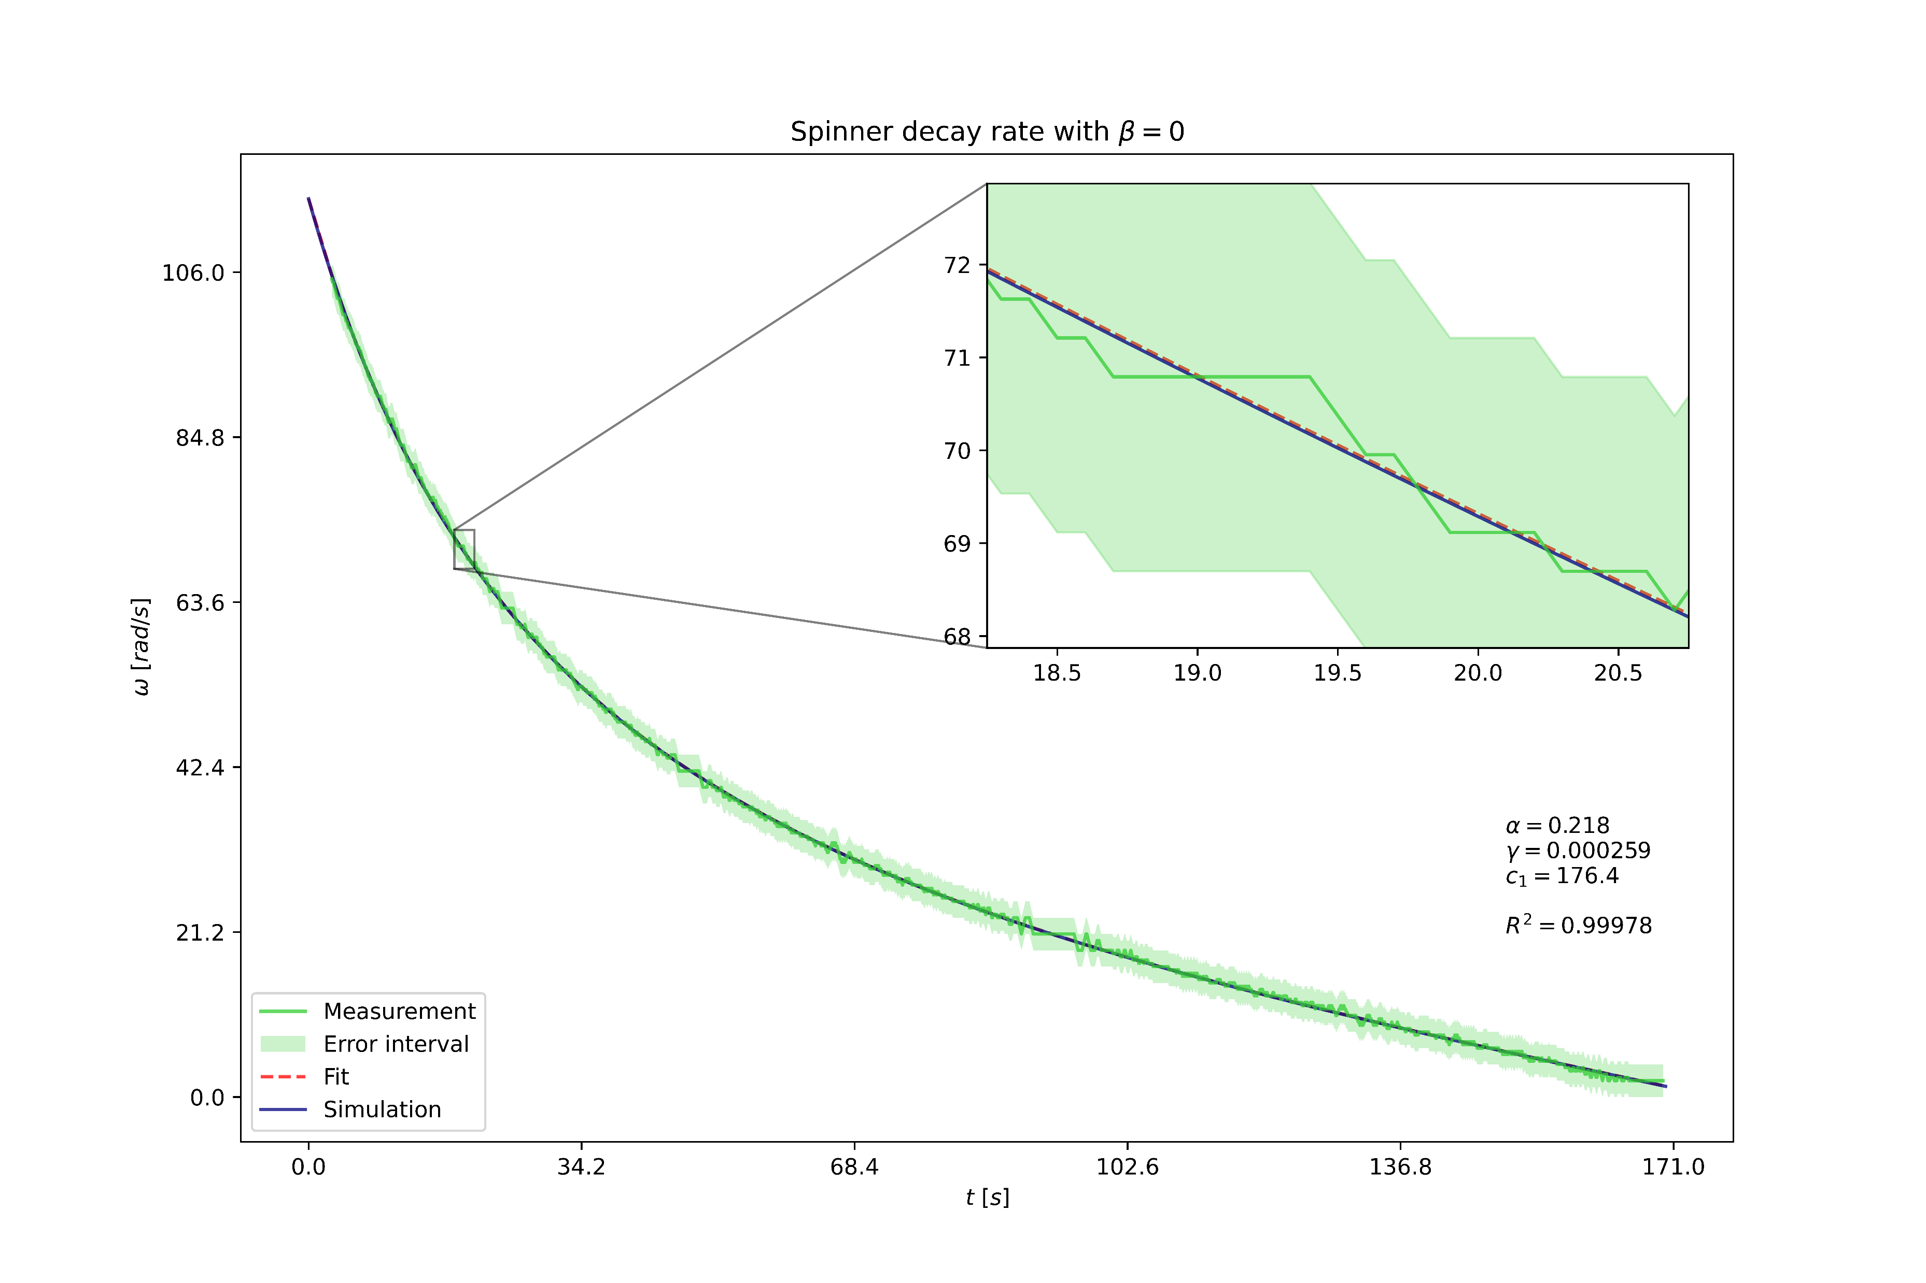

Drag – Comparison of models
Measurements
Notes:
Here we compare how well our simulation handles the linear component
The measurements is exceptionally close to the theory

Slide 9
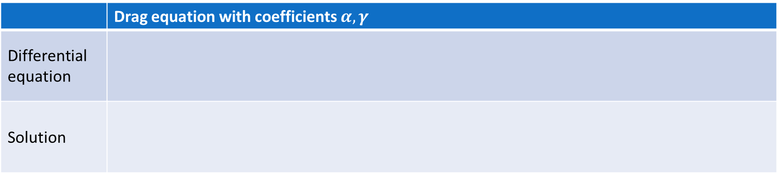
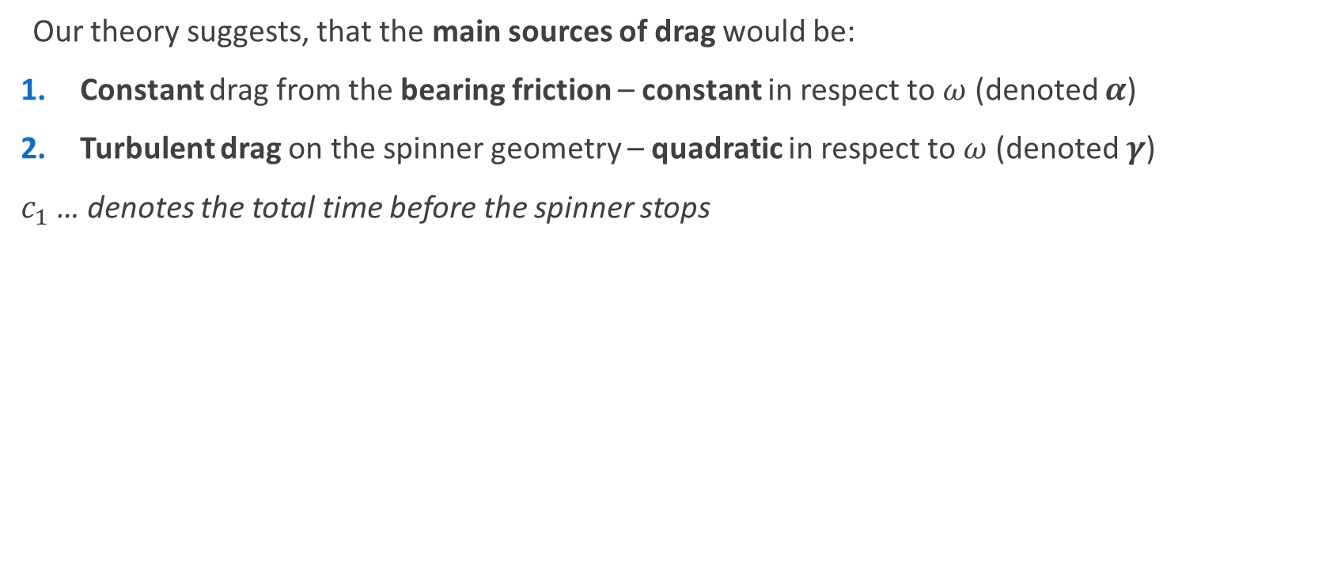
Drag – Analytical solution
Measurements
Our theory suggests, that the main sources of drag would be:
Constant drag from the bearing friction – constant in respect to $ω$ (denoted $α$)
Turbulent drag on the spinner geometry – quadratic in respect to $ω$ (denoted $γ$)
$c_{1}$ … denotes the total time before the spinner stops
 | Drag equation with coefficients $α,γ$
Differential equation
Solution
($0≤t≤c_{1}$)

Slide 10
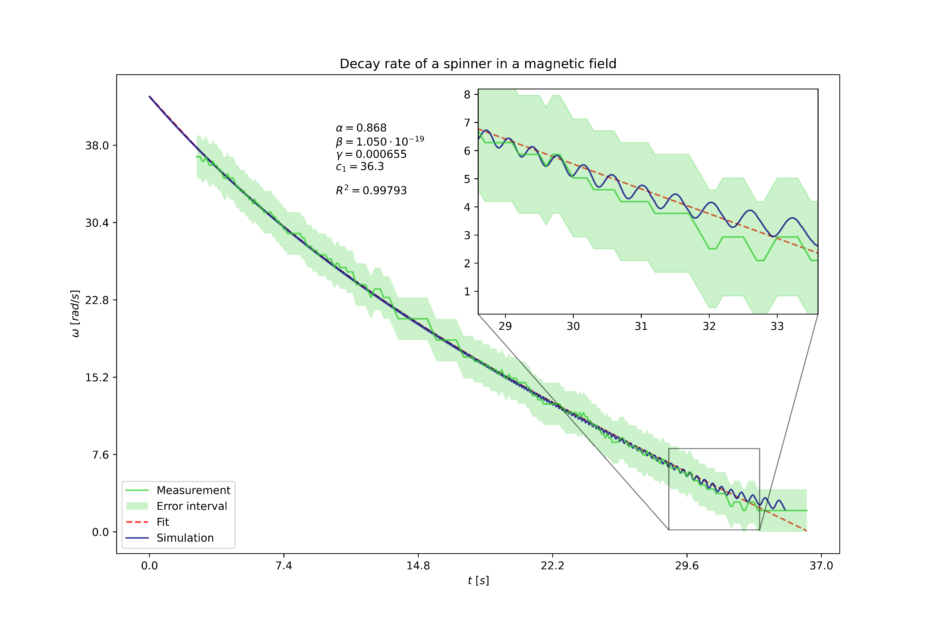
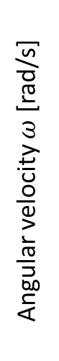
Drag – Comparison with measurement
Measurements
Spinner decay in time
No external magnetid field
In a „quasi-homogenous“ magnetic field
Angular velocity $ω$ [rad/s]
Time $t$ [s]
Time $t$ [s]
Notes:
Here we compare how well our simulation handles the linear component
The measurements is exceptionally close to the theory

Slide 11
Drag – External magnetic field
Additional information
The large magnet is modeled as a single magnetic dipole at its center
Notes:
Draw the magnet layout!!

Slide 12
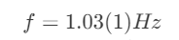
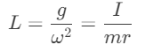
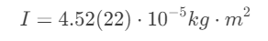

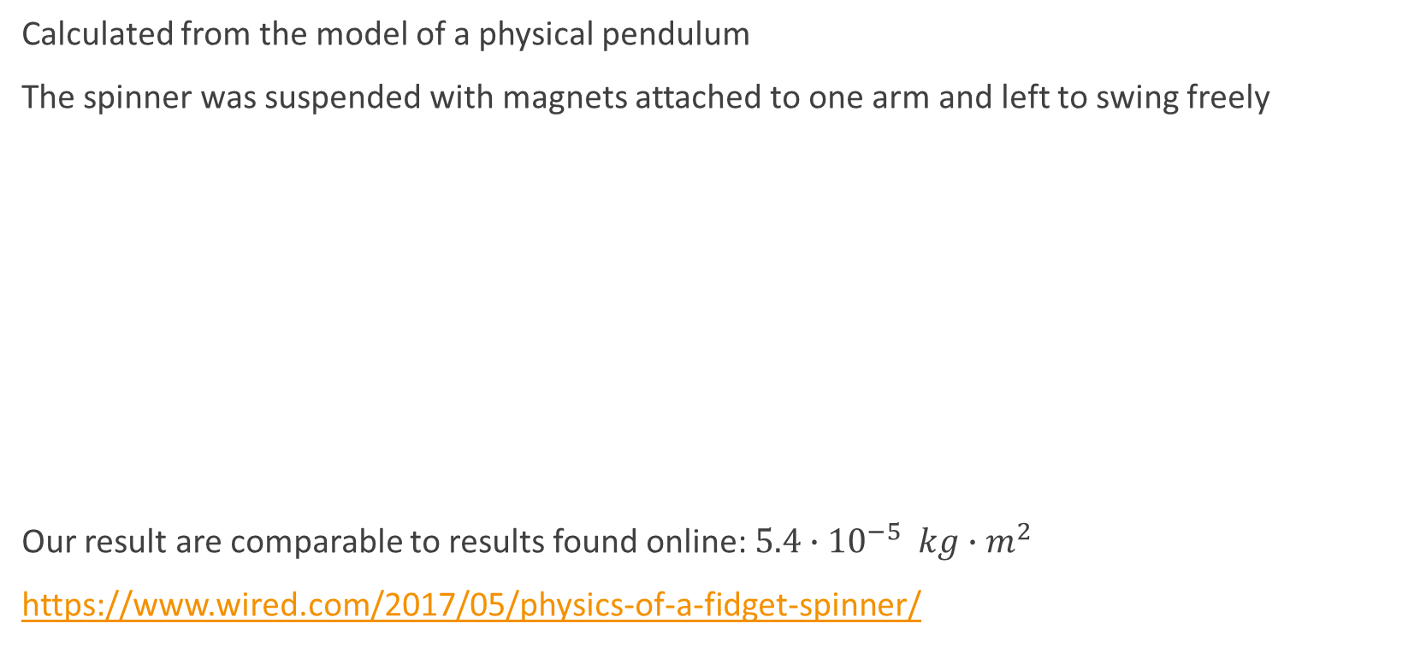
Moment of inertia $I$
Additional information
Calculated from the model of a physical pendulum
The spinner was suspended with magnets attached to one arm and left to swing freely
Our result are comparable to results found online: $5.4{∙10}^{−5} kg∙m^{2}$
https://www.wired.com/2017/05/physics-of-a-fidget-spinner/
Notes:
Moment of inertia = moment setrvačnosti
Angular momentum = moment hybnosti
Torque = moment síly
Physical pendulum = fyzické kyvadlo

Slide 13
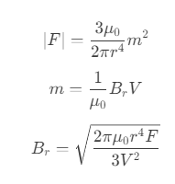
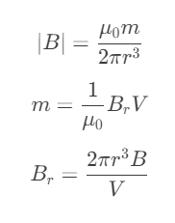
Remanence
Additional information
Can be either calculated from the generated magnetic field or from the force between the magnets
Simplifying the previous equations for dipole force and magnetic field:
We used both methods:
The force was measured via a scale (used for a singular magnet)
The field was measured using a mobile phone magnetometer (with the Earth‘s magnetic field being accounted for)

Slide 14
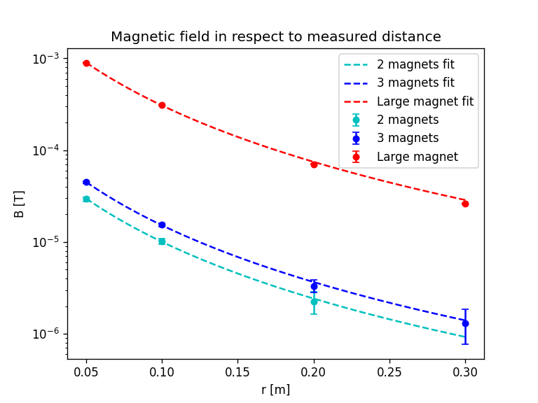
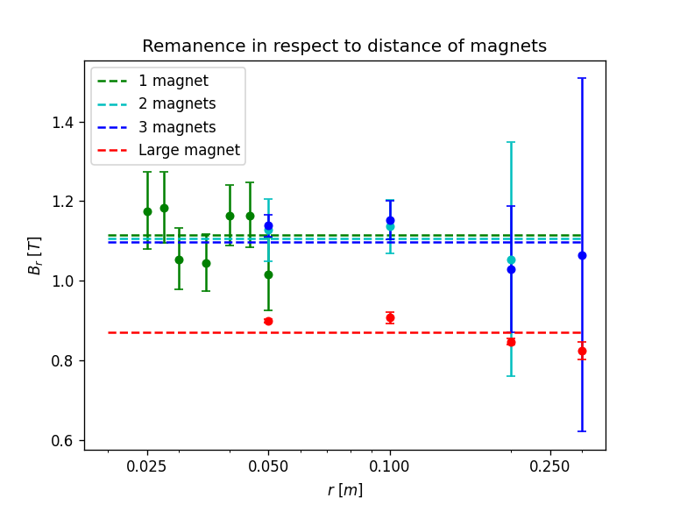
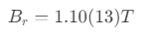
Remanence - results
Additional information
We measured for 1, 2 and 3 cube magnet stacks as well as a larger (old) NdFeB magnet

Slide 15
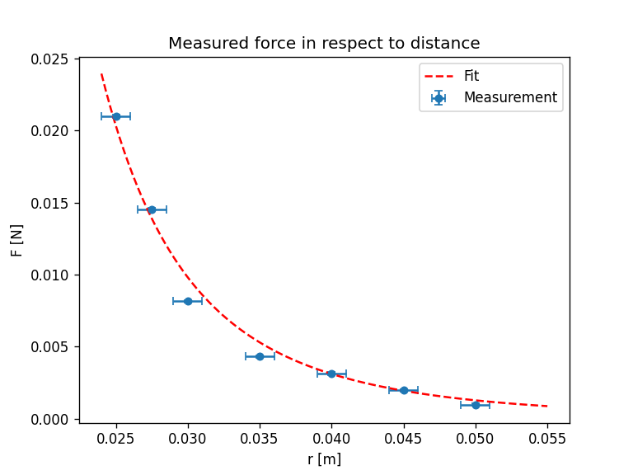
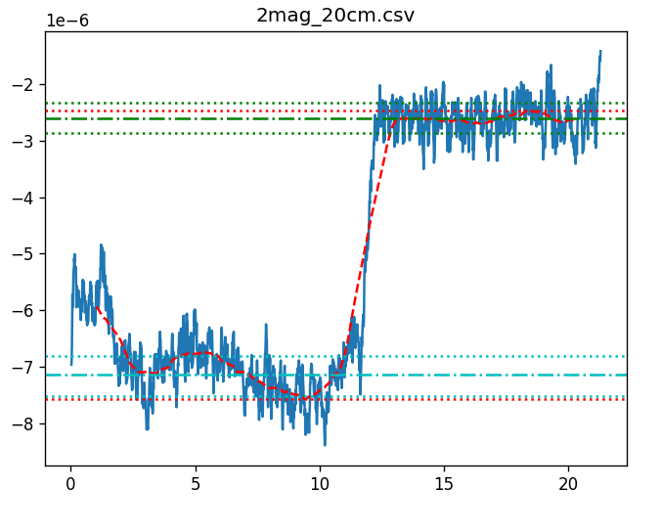
Remanence – more data
Additional information
B [T]
t [s]

Slide 16
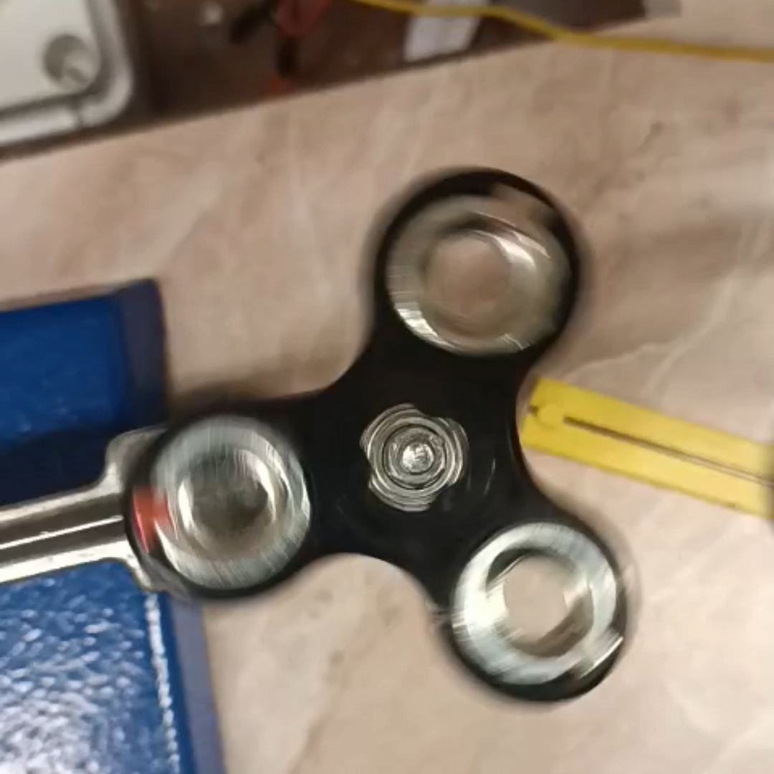
Magnetic coupling
Driven spinner exp.
Two spinners (one driven) rotating at roughly the same velocity => coupling
Qualitative notes:
Gradual changes do not break the coupling; abrupt changes do
The higher the driving velocity is, the less velocity mismatch is acceptable
Different modes (velocity ratios) are also possible, though even less forgiving
Observed modes are multiples (2:1, 3:1 …) or integer reciprocals (1:1, 1:2 …) of the driving velocity
Notes:
We observed, that when two spinners (with one being driven by a motor) are rotating at roughly the same velocity, the second spinner becomes coupled and continues keeping the same velocity even during gradual changes

Slide 17
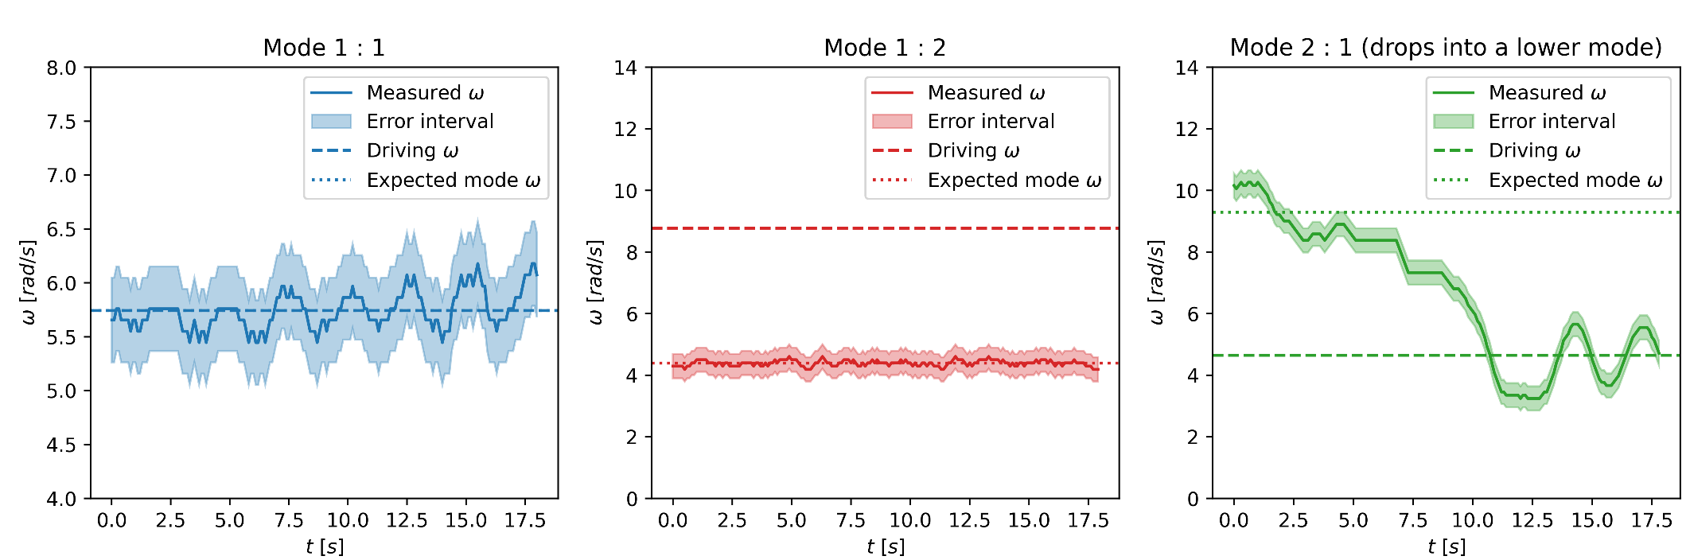
Magnetic coupling results
Driven spinner exp.
Notes:
Oscillation when dropping into a lower mode! We‘ll talk about that later some more

Slide 18

Magnetic coupling results
Driven spinner exp.

Slide 19
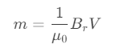
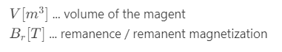
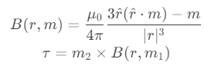
Simulation - Relevant phenomena
Simulation
Magnet interactions
We used cubic NdFeB magnets (5mm, grade N35)
We modeled each magnet as a magnetic dipole
Force interaction:
Torque due to generated magnetic field:
Other forces on the spinner – we were not able to simulate these:
Concentric forces on the ball bearing => increasing friction
Oscillations and rattling of the ball bearings
Magnetic dipole moment:
Notes:
Magnetic dipole approximation breaks down at small distances (comparable to the size of the magnet)

Slide 20
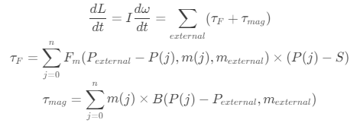
Simulation - Implementation
Simulation
Takes the initial state as input:
Positions of spinners, initial angles and angular velocities (only in 2D)
Each magnet interacts with every other magnet using the magnetic dipole model
From this we calculate the torques on all the spinners:
The simulation is further improved using the RK4 method
Notes:
Two RK4 passes

Slide 21
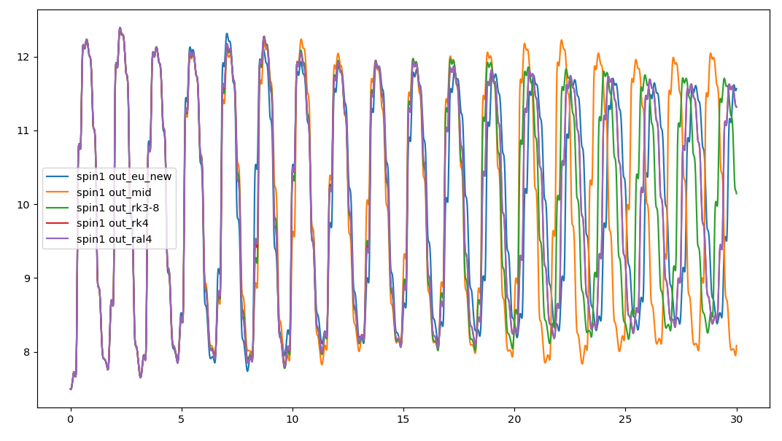
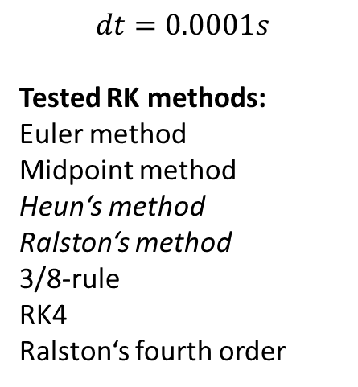
Simulation – Methods
Additional information
$$dt=0.0001s$$
Tested RK methods:
Euler method
Midpoint method
Heun‘s method
Ralston‘s method
3/8-rule
RK4
Ralston‘s fourth order
Notes:
Two RK4 passes

Slide 22
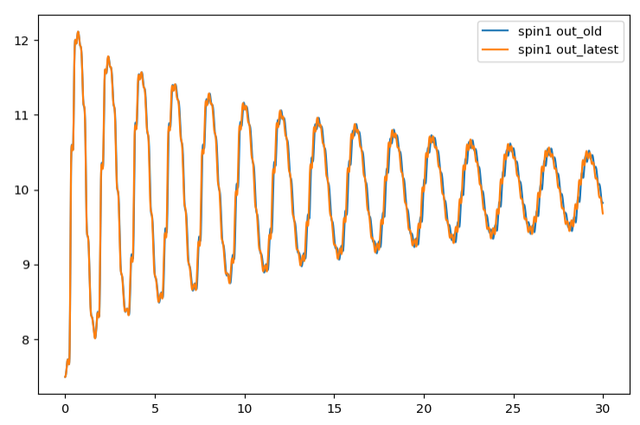
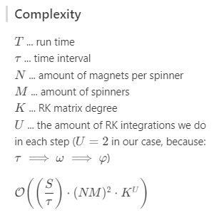
Simulation – Methods
Additional information
Single RK4 pass (blue) versus
Double RK4 pass (orange)
Notes:
Two RK4 passes

Slide 23
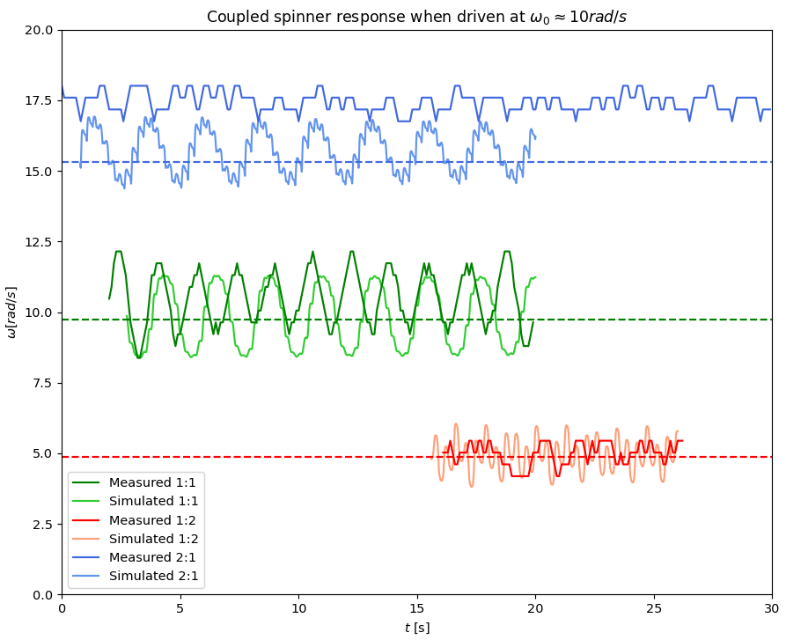
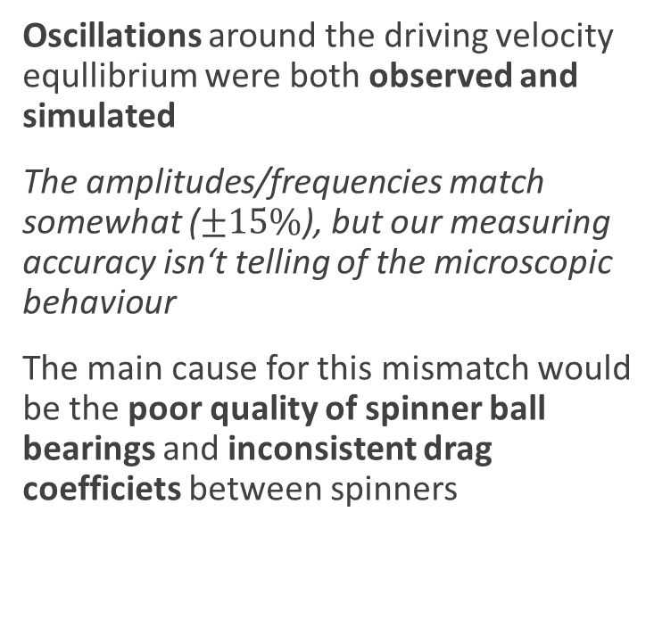
Simulated coupling
Simulation
Oscillations around the driving velocity equllibrium were both observed and simulated
The amplitudes/frequencies match somewhat ($±15\%$), but our measuring accuracy isn‘t telling of the microscopic behaviour
The main cause for this mismatch would be the poor quality of spinner ball bearings and inconsistent drag coefficiets between spinners

Slide 24
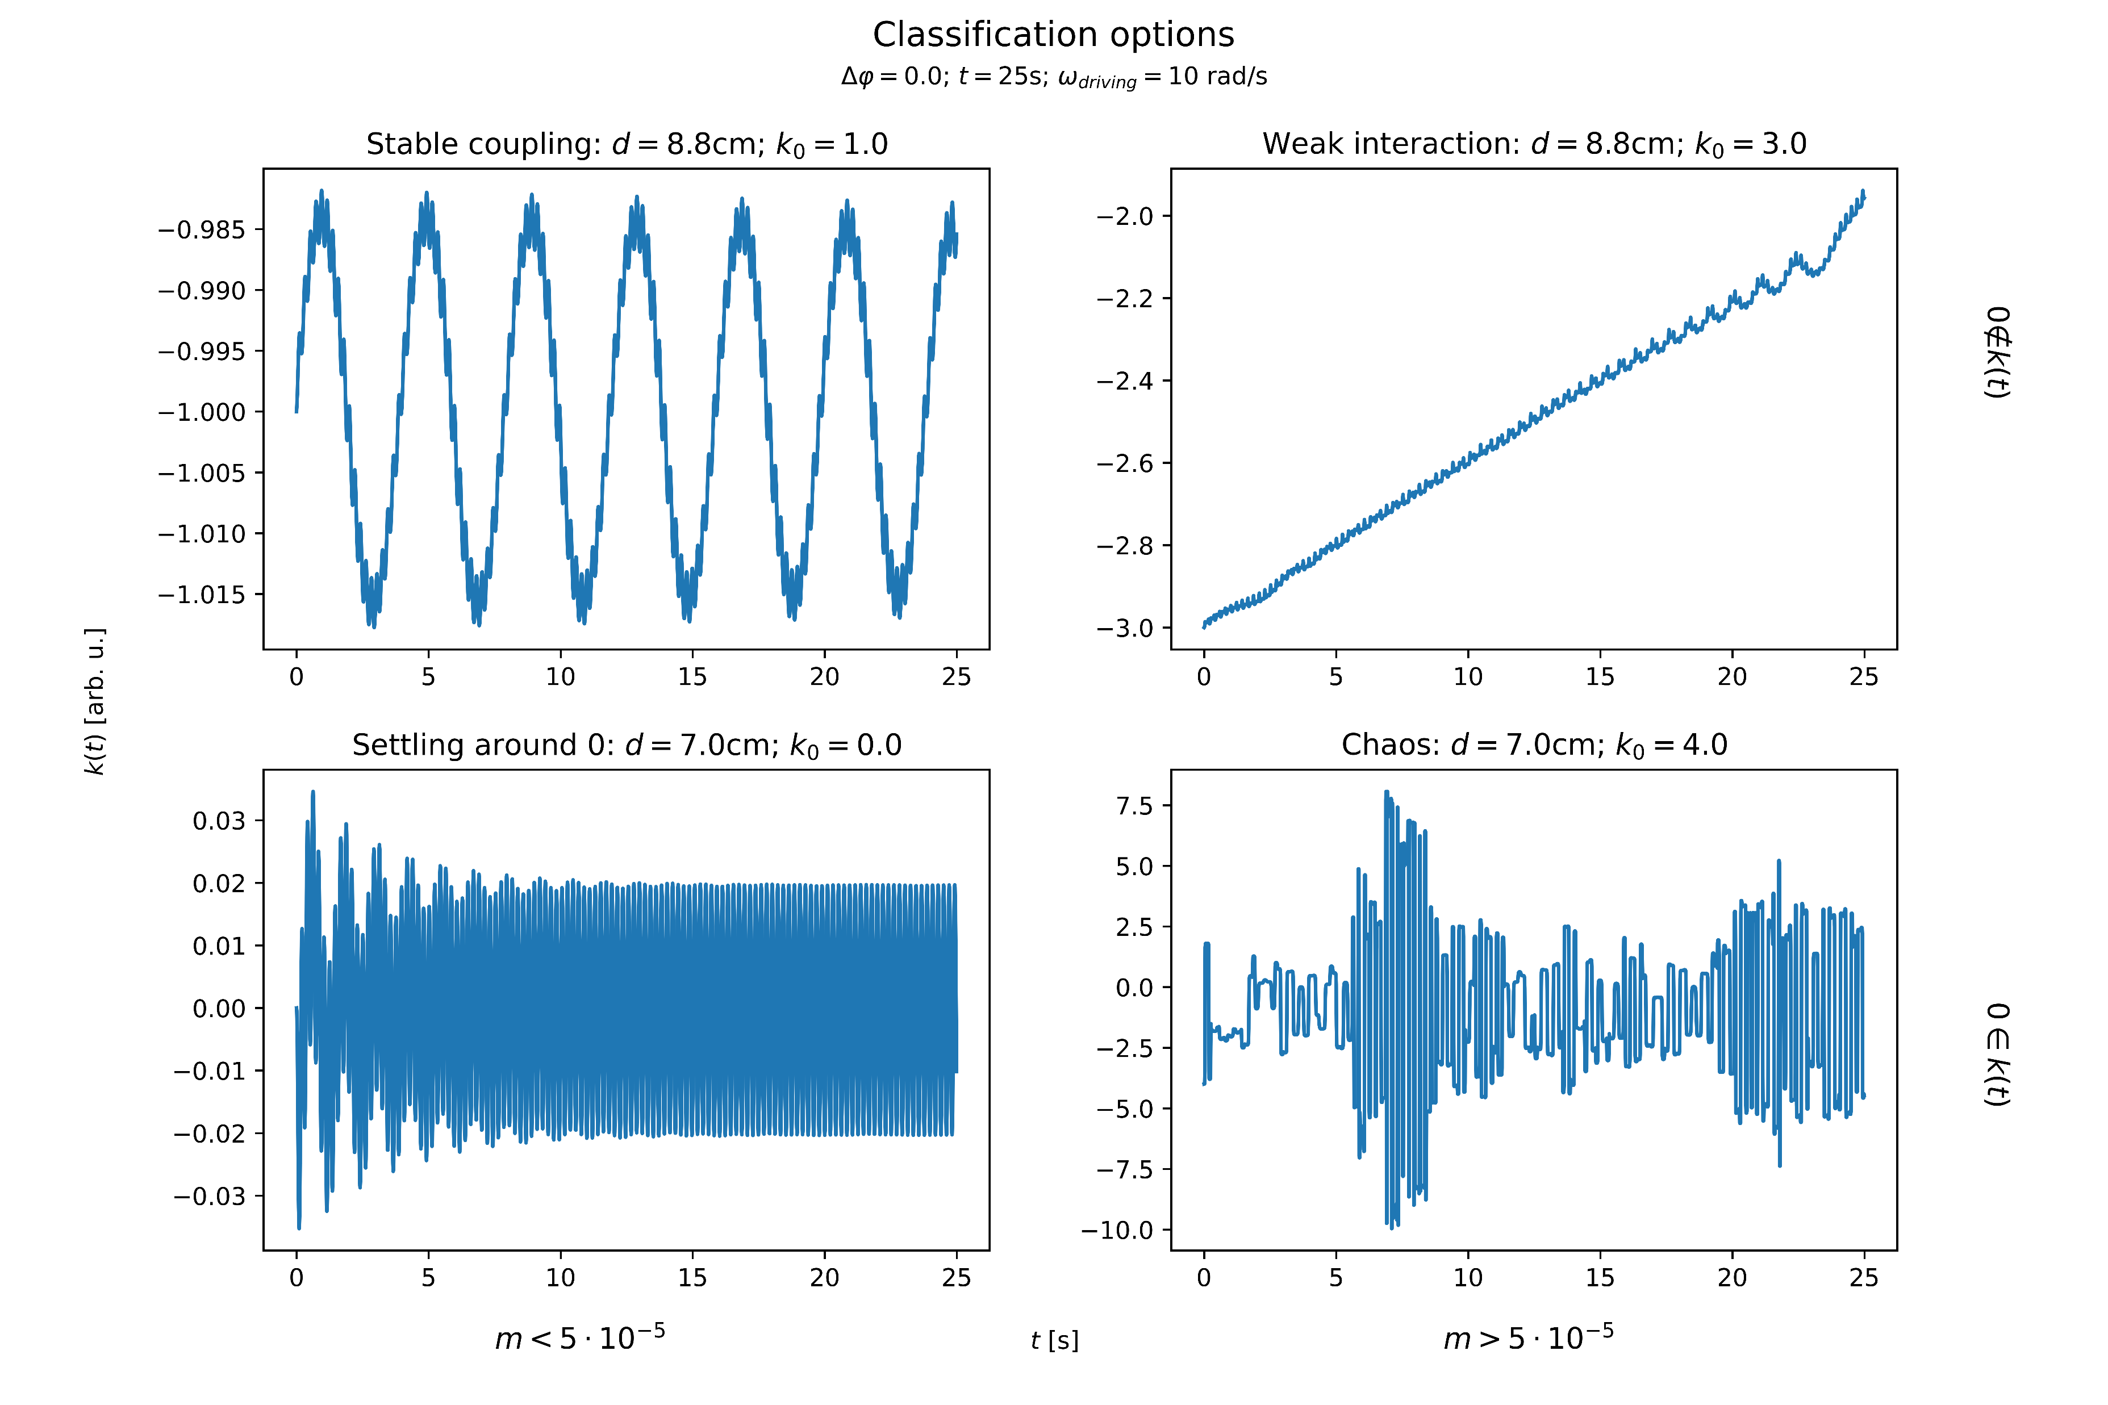
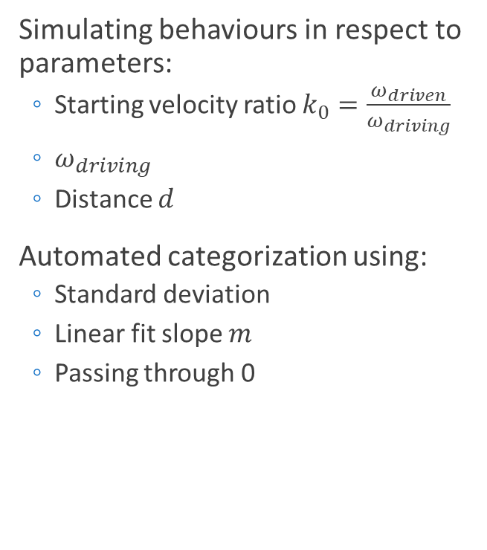
Chaos categorization
Chaos
Simulating behaviours in respect to parameters:
Starting velocity ratio $k_{0}=\frac{ω_{driven}}{ω_{driving}}$
$ω_{driving}$
Distance $d$
Automated categorization using:
Standard deviation
Linear fit slope $m$
Passing through 0

Slide 25
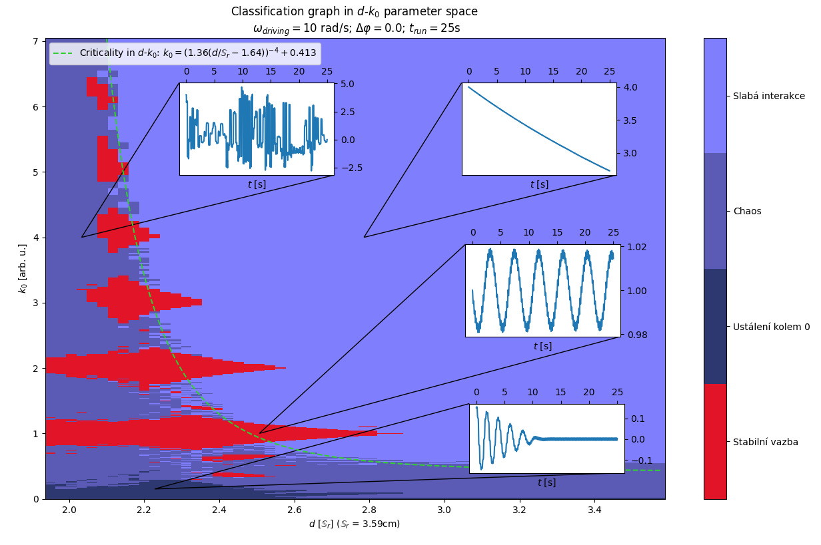
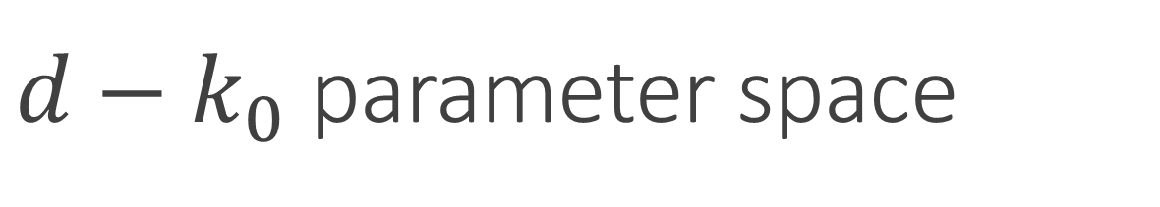
$d−k_{0}$ parameter space
Chaos
The stable interval size tapers off with increasing distance
Critical line between chaos and weak interaction
Increasing mode islands get smaller in size
Non-integer modes are also observed

Slide 26
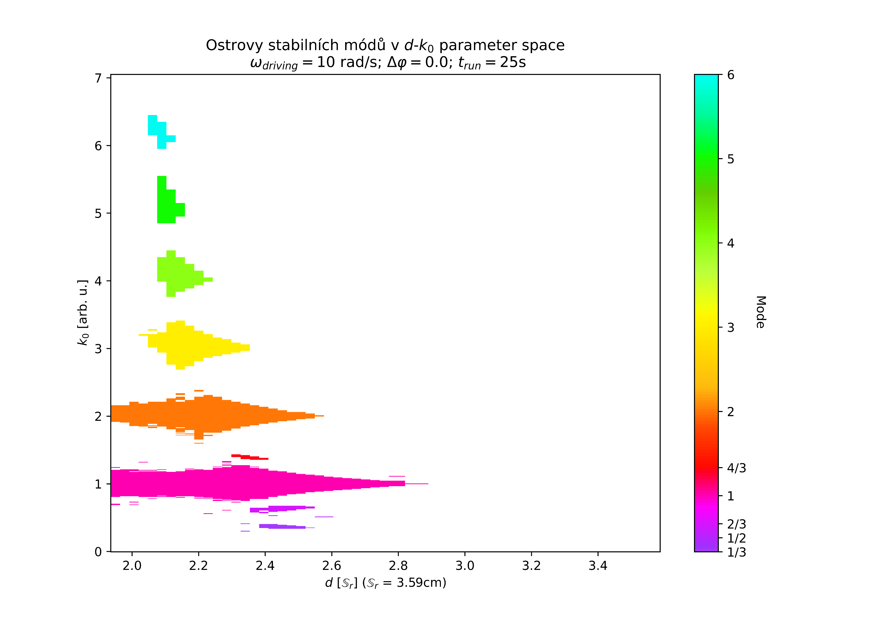
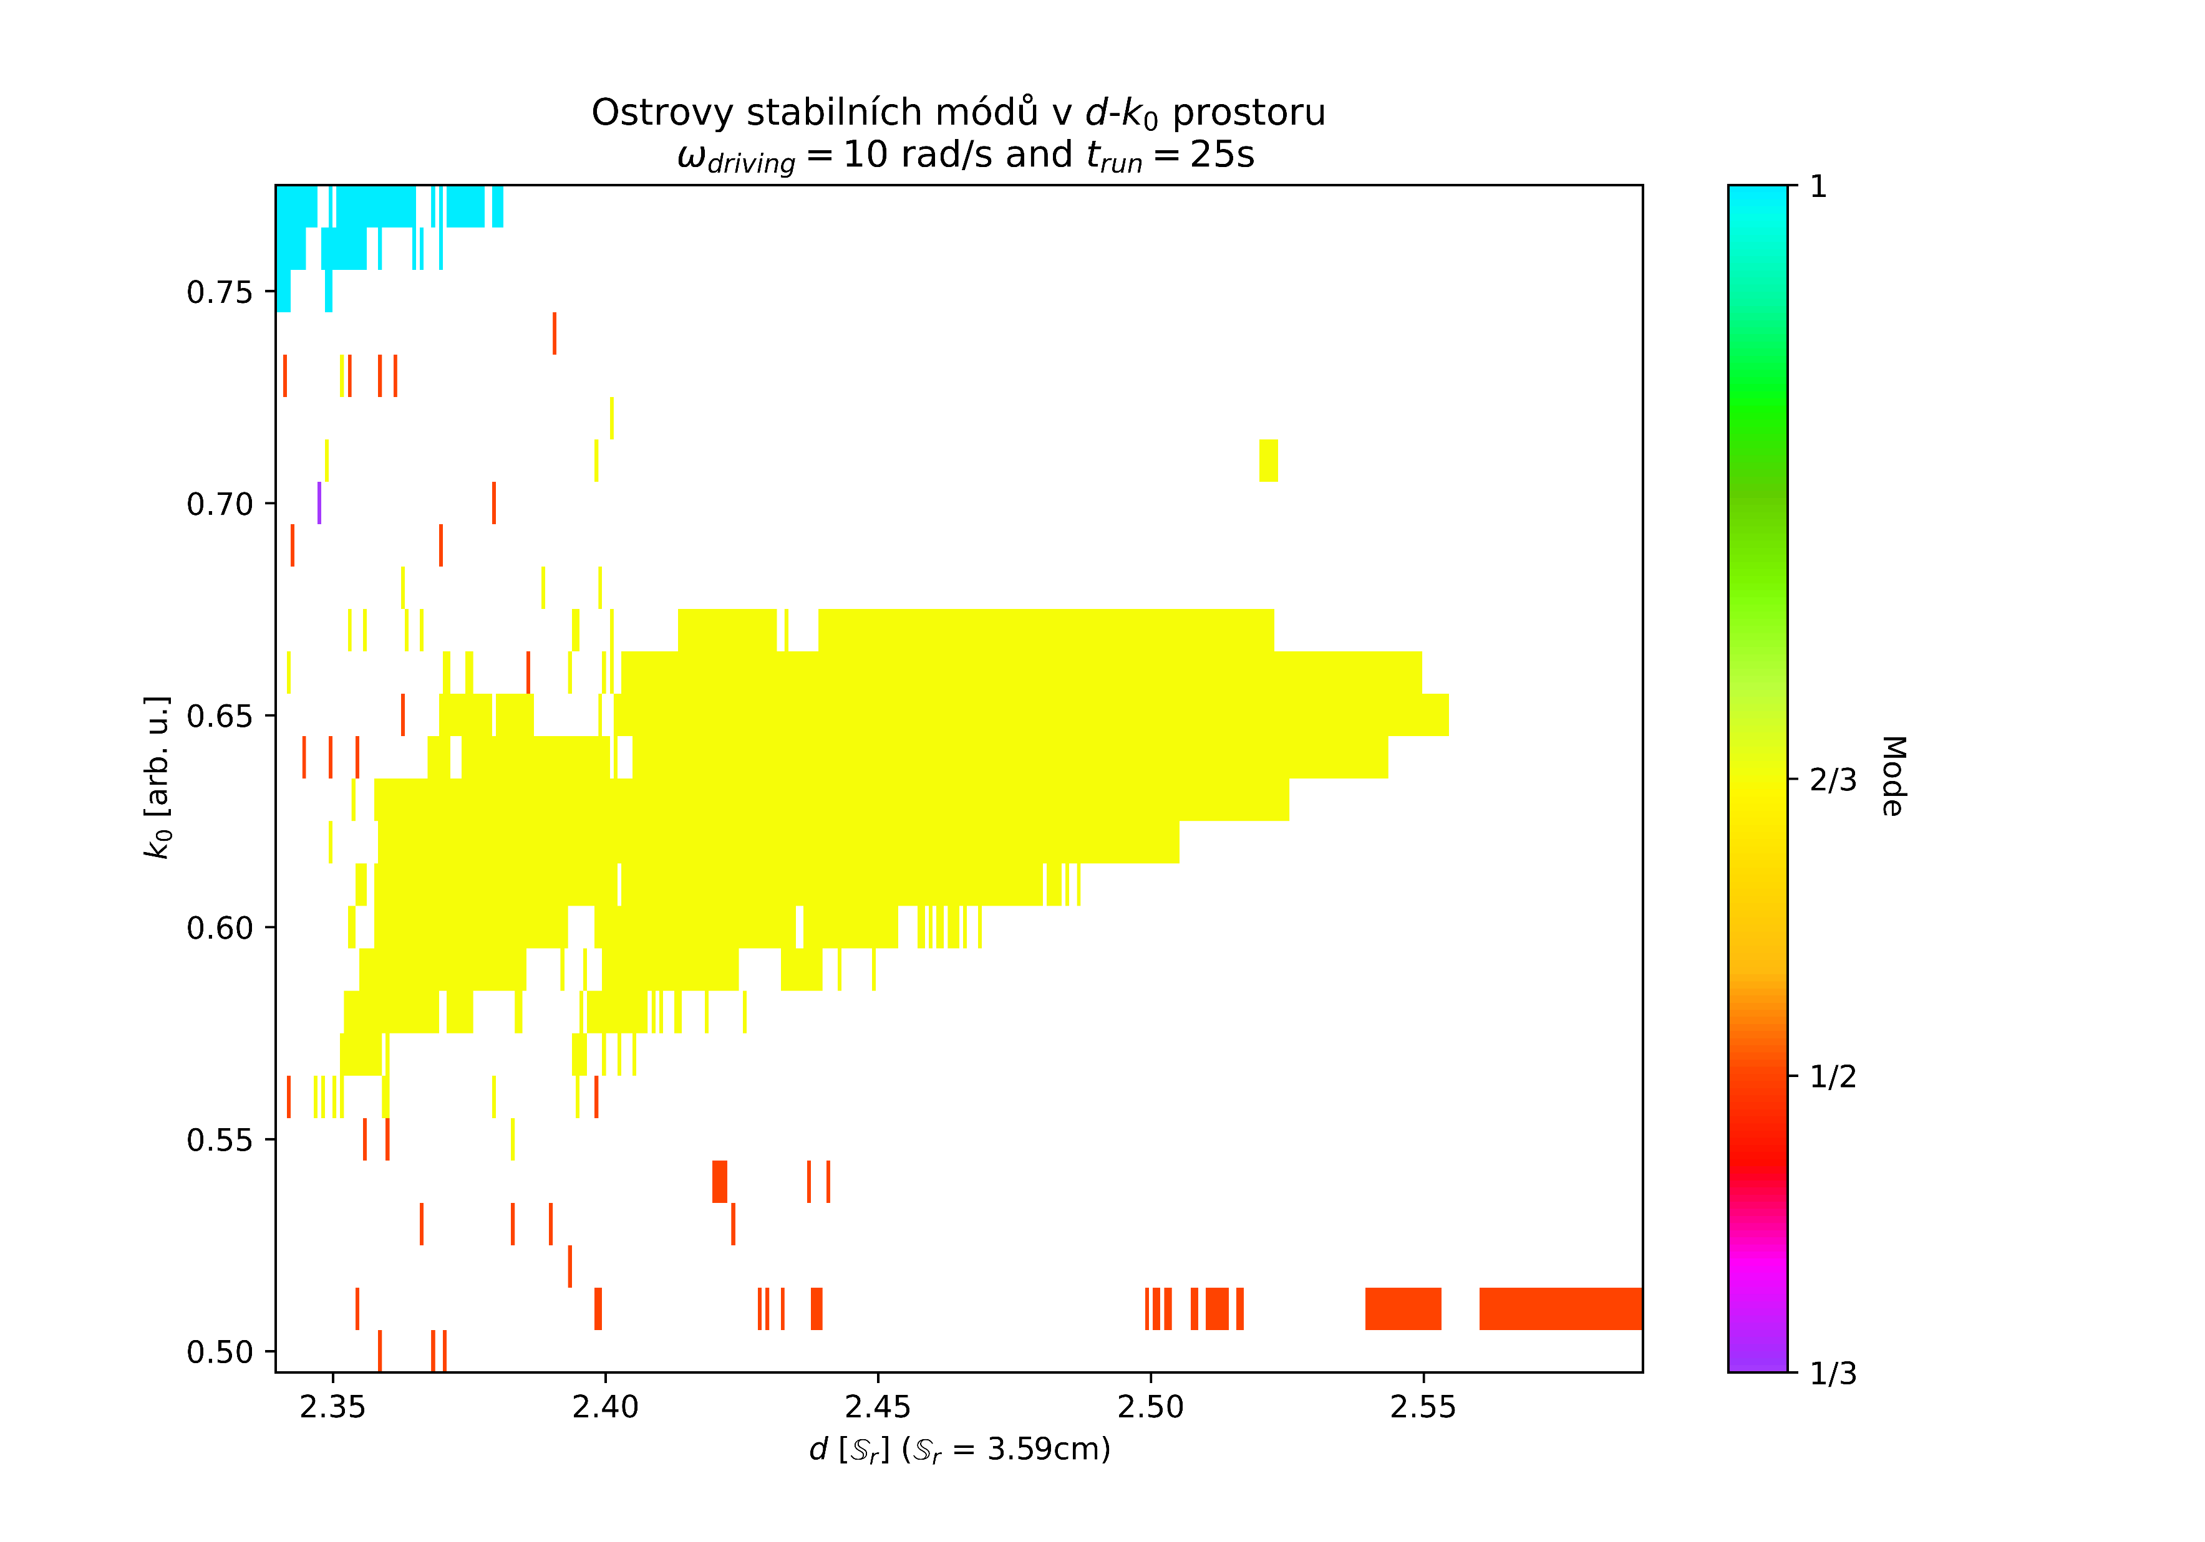
$d−k_{0}$ parameter space
Chaos

Slide 27
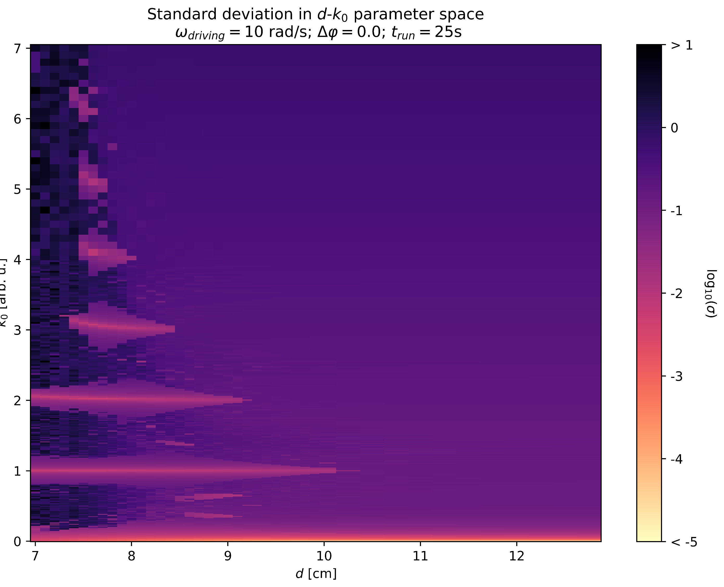
$d−k_{0}$ parameter space
Chaos

Slide 28


$ω_{driving}−k_{0}$ parameter space
Chaos
The stable interval size tapers off with increasing driving velocity
New, previously unobserved, non-integer modes also occured:
3:2, 4:3, 6:5, 2:3
Fractal-like borders around stability island 1:1 are observed

Slide 29


$ω_{driving}−k_{0}$ parameter space
Chaos

Slide 30


Sub-period behaviour
Additional information
Our algorithm compares the behaviour of an undisturbed spinner and a driven (disturbed) spinner
The angular displacement of an undisturbed spinner grows linearly in time (constant angular velocity)
We also talk about a „sub-period (denoted $T$)“ which means the time it takes for the spinner to rotate from one arm to the next arm
Measurements were done using a Vernier magnetic field meter

Slide 31

Sub-period behaviour - Angle
Additional information

Slide 32

Sub-period behaviour - Velocity
Additional information
The extremely high error is due to the algorithm used, which has high uncertainty when the tangent is close to 0
Many other phenomena, like the rattling of the bearing, might be having effect on the real velocity during one sub-period => simulation and measurement doesn‘t match up too well

Slide 33


Torque transfer - Setup
Driven spinner exp.
The driven spinner has a metal plate added to it to increase air resistance
Measuring the transferred torque from the maximum angular velocity, at which the spinners stay coupled

Slide 34




Air drag
Torque transfer
The $γ$ parameter has increased tenfold after adding the resisitive plate
A naive air drag model could also be devised like so:

Slide 35



Braking torque
Torque transfer
The braking torque grows quadratically in respect to angular velocity
The naive air drag model is not awfully far off, but the $C_{D}$ coeficient is very debatable, which is why we didn‘t use this in the end
We can use this to get the torque transferred to the coupled spinner
$$τ_{braking}=−Iγω^{2}$$
$$τ_{braking}=−4.09⋅{10}^{−7}ω^{2}$$

Slide 36


Braking torque calculation
Additional data
$ω\left(t\right)=−\sqrt{\frac{α}{γ}}\tan\left(\sqrt{αγ}\left(t−c\right)\right)$ $t\left(ω\right)=c+\frac{\tan^{−1}\left(−\sqrt{\frac{γ}{α}}ω\right)}{\sqrt{αγ}}$
$τ\left(t\right)=I\dot{ω}=−Iα\sec^{2}\left(\sqrt{αγ}\left(t−c\right)\right)$
$τ\left(t\left(ω\right)\right)=τ\left(ω\right)=−Iα\sec^{2}\left(\tan^{−1}\left(−\sqrt{\frac{γ}{α}}ω\right)\right)$
$τ\left(ω\right)=−Iγω^{2}+Iα$
$$\sec^{2}\left(\tan^{−1}\left(x\right)\right)=x^{2}+1$$

Slide 37


Torque transfer results
Torque transfer
We measured the transferred torque in respect to: spinner to spinner distance, magnet count

Slide 38



Power transfer
Torque transfer
$$P=ωτ$$
Maximum transferred power $P=\left(50±6\right)mW$ when $n_{mag}=3$ and $d=8.2cm$
Notes:
(There is no physical background, to support the actual shape of the fit)

Slide 39


Transfer efficiency
Torque transfer
We measured the transfer efficiency in respect to: spinner to spinner distance, magnet count
The efficiency is very low (<1%) !FIX THIS! !FIX GRAPHS!
Notes:
(There is no physical background, to support the actual shape of the fit)

Slide 40
Torque transfer improvements
Torque transfer
Some of the reasons, why the efficiency is so low:
In normal magnetic transmissions, alternating pole-pairs are used instead of individual magnets with the same orientation
The magnetic field lines travel mostly through air, thus decreasing the efficiency
The torque on the magnetic moments in the vertical orientation is always zero – changing the orientation could improve the efficiency
The magnets are only repelling each other, but attraction might be helpful in stabilizing the transfer

Slide 41




Magnetic transmissions
Magnetic transmissions
Changes required to increase torque transfer:
Magnet distance reduction
Increased magnetic strength
Use of pole pairs (PP) $→$ magnetic teeth
Using magnetic teeth, we can create magnetic equivalents of almost all standard mechanical gears
Better than mechanical gear equivalents, however, are more complex gears using a modulator
Notes:
Na principu podobném našim spinnerům fungují i magnetické převody, které jsou řádově silnější.
Hlavním rozdílem mezi spinnery a mag. převodovkami je použití pólových párů s opačnými póly vedle sebe.
Tímto se vytvoří takový pomyslný magnetický zub a pomocí toho jsme schopni vytvořit magnetické ekvivalenty všech možných ozubených soukolí.
Lepší jsou však magnetické převody, které používají tzv. modulátor.
--------------------------------------------------------
Šnekový převod
ozubený hřeben s pastorkem
kuželové ozubené kolo
vnější čelní ozubené kolo
vnitřní čelní ozubené kolo
planetové soukolí

Slide 42




Magnetic transmissions- principle
Magnetic transmissions
An appropriately designed modulator modulates the MFL of the outer rotor in such way, that they match with the inner rotor
Fixed oute rotor:
PP count:
$$p_{in}=4 \\ p_{out}=22$$
Fixed modulator:
Modulator steel poles:
Notes:
Modulátor, jak již z názvu vyplývá, moduluje magnetický tok tak, aby perioda vnějšího rototu odpovídala periodě vnitřního rotoru.
K modulování se používají látky s vysokou permeabilitou a počet modulátorových nástavců musí být roven součtu vnitřních a vnějších pólových párů.
Modulace funguje tak, že každý modulátorový nástavec je posunut o krapet menší úhel, než je úhel mezi vnějšími pólovými páry.
Tím získáváme plynulou vlnu, jejíž perioda je stejná jako perioda vnitřního rotoru.
…

Slide 43


Our design (2. version)
Magnetic transmissions
Modulator gearbox with ratio 1:3 or 1:4
3D design: Fusion 360
Comprised of 5 parts:
Inner rotor
Modulator body
Modulatir cap
Outer rotor body
Outer rotor cap
NdFeB N42 3x4x22mm magnets
$p_{in}=4;p_{out}=12;q_{m}=16$
Modulation done via transformer steel plates
Notes:
No a nyní se dostáváme k mému vlastnímu návrhu.
Jedná se o modulátorovou převodovku s převodem 1:3.
Byla navržena v programu Fusion 360 a skládá se z 5 částí.
Vnitřní rotor má 4 PP, vnější 12 PP a tedy 16 modulátorových nástavců.

Slide 44



Design detail
Magnetické převody
Notes:
Zde je detail a řez návrhem.
Vlevo vidíme modulátor s drážkami na vložení nástavců.
Uprostřed je vnější rotor, který v sobě má 24 otvorů pro magnety.
Vpravo je vidět řez modelem.

Slide 45






Transmission characteristics
Magnetic transmissions
Torque during skip-period at different angular velocities
Maximum torque and recoil in respect to $ω$
Torque $τ$ [Nm]
Torque $τ$ [Nm]
Period count [arb. u.]
Angular velocity $ω$ [rad/s]

Slide 46
Summary
Summary
We successfully observed, sustained and simulated the magnetic coupling of spinners
We determined the transferred torque and power
We have a working simulation, which we‘ve compared with measurements
Using the simulation we deduced fractal-like behaviour in respect to multiple parameter
We analytically modeled the effects of drag and confirmed our model with measurements:
We measured the parameters of our spinners and magnets
We created a functioning magnetic gearbox

